Slide 1
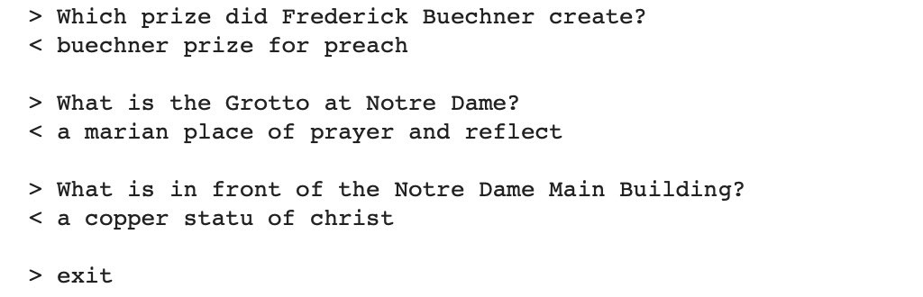
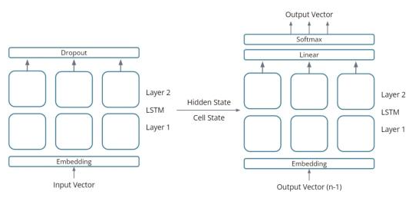
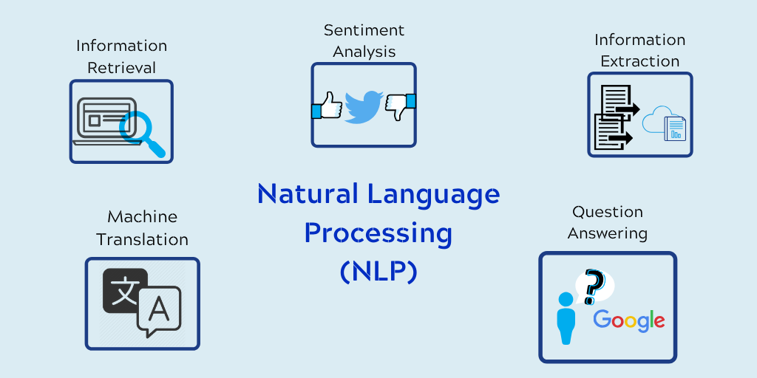

MAJI AI CHATBOT
Introduction
Recurrent Neural Networks
Evaluation
The goal of our project is to create an AI chatbot that can assist clients with technical problems with electrical goods. Our research question is: "How can we design a chatbot that can understand customers' technical issues and provide appropriate solutions?"
Our AI chatbot will use recurrent neural networks (RNNs), which require more memory because current output depends on historical inputs. RNNs are based on the Seq2Seq architecture, a more sophisticated LSTM implementation. Long short-term memory gives neural networks a mechanism to transition between recalling recent information and information from a long time ago.
We conducted a user study to evaluate the performance of our chatbot. We measured the chatbot's ability to understand the customer's technical issue, provide appropriate solutions, and handle multi-turn conversations. We also asked for feedback from the customers on the chatbot's usefulness, accuracy, and ease of use.
Implementation
Our AI chatbot is developed using machine learning and natural language processing (NLP) techniques.
Natural Language Processing (NLP)
Conclusion
Our chatbot utilizes natural language processing (NLP) to decipher client messages, pinpoint the technical problem, and gather necessary information such the product model, issue description, and error codes.
In conclusion, we have created an AI chatbot that can comprehend technical difficulties from consumers and offer suitable answers. In order to give clients a precise and customized experience, our chatbot makes use of the most recent machine learning and natural language processing algorithms. We have shown the efficacy and utility of our chatbot through our user study. We discovered that creating a chatbot with technical understanding involves both technical know-how and customer-centric design.
Knowledge Base
Our chatbot has a knowledge base of frequently asked questions and technical issues related to electronic products. It can provide relevant solutions from the knowledge base, ensuring that the customers receive accurate and useful information.
UNIVERSITY OF THE PACIFIC
Kaung Min Sett & Vivek K. Maheshwari

